Slide 1
WSO:
Mock Client Call
Candidate Interview with Kristen Davis

Slide 2
Meeting Objectives
CURRENT ASSET STATE
REVIEW REVENUE STREAM
SET ACTION PLAN
Breakdown current meter state by make, age, accuracy and size
Walkthrough current revenue & potential earnings gap
Deliver key takeaways, potential ROI, and next steps

Slide 3
Key Takeaways
01
02
03
Replace Lowest Performing Meters Immediately
Inspect Meter With Potential Recording Errors
Build Predictive Model to Plan for Future Expenses

Slide 4
Current Asset State
01.
Overview of current meters by make, size, age

Slide 5
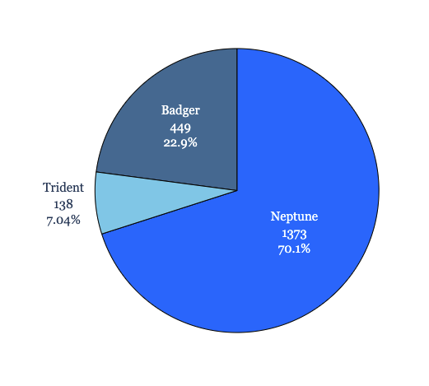
Meter Model
More than ⅔ of total sample data were ‘Neptune’ model meters
Total Units Analyzed:
1,960*
Count of Meters Currently in Service:
Badger: 172,745
Neptune: 166,182
Trident: 13,897
*Data from two meters not included in analysis due to missing meterID data

Slide 6
Meter Size Report
⅝ inch meter model most prevalent meter size across model type
⅝” (0.625) | 1,920 units | The smallest meter model in the dataset, the largest quantity of meters were at this size across all three meter types
¾” (0.75) | 3 units | Meter size only available in data set in the Badger and Neptune model, lowest prevalence of size in data set
1” (1.00) | 37 units | The largest meter model in the dataset, the majority appearing in the Badger meter model but present across all meter types

Slide 7
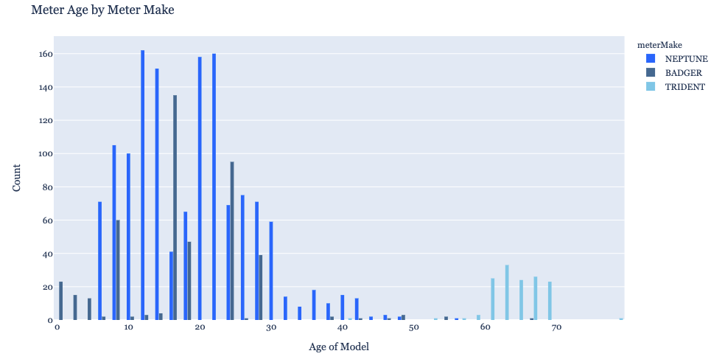
Meter Model Age
The majority of units analyzed are between 10 & 30 years old with Trident make models trending the oldest

Slide 8
Revenue Review
02.
Walkthrough current revenue & potential earnings gap

Slide 9
Modeled 2019 Earnings
Revenue Break Down
$5.09
53,988,433
$367,355.64
Customer Retail Cost Per CCF
Total 2019 Recorded Water Use (CCF)
Total earnings based on recorded water usage

Slide 10
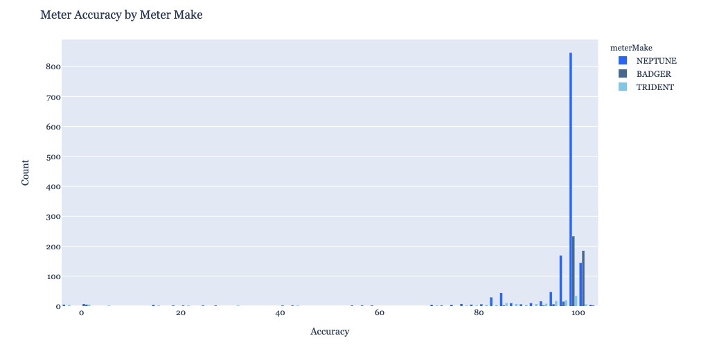
Meter Accuracy
85% of meters recorded a higher than 95% accuracy rating, small number of units account for large % of inaccuracy
1,700 (86%) of all units analyzed had reported Accuracy scores at or above 95%. The long left tail of data represents a small number of meters but an outsized effect on overall accuracy.

Slide 11
Inaccuracy Impact
Evenly a relatively low overall loss rate due to inaccuracy results in large loss in water & profits
4.3%
Overall Average Gallons Lost Due to Inaccuracy
2,321,502
Unrecorded gallons of water yearly
$15,796.29
Potential 2019 Missed Earnings

Slide 12
Action Plan
03.
Deliver key takeaways, potential ROI, and next steps

Slide 13
Key Takeaways
01
02
03
Replace Lowest Performing Meters Immediately
Inspect Meter With Potential Recording Errors
Build Predictive Model to Plan for Future Expenses
MeterIDs pre identified for immediate actionable wins

Slide 14
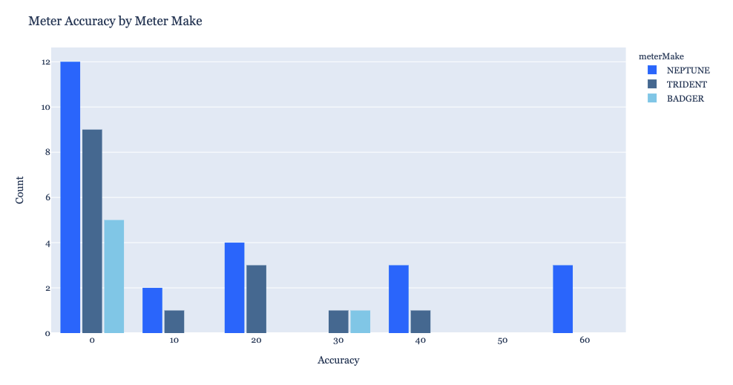
Meter Model Accuracy
22 meters record for nearly 0% accuracy scores, accounting for a huge proportion of lost revenue

Slide 15
Replace Lowest Performing
01
96%
Mean Meter Accuracy
45 Meters
< 70% Accurate
2.3%
Overall Inventory
$6,750
Price to replace identified units

Slide 16
Inspect Meter With Potential Accuracy Errors
02
Automate Flagging
Identify meters returning accuracy scores < 0 & > 100
Target Inspection Efforts
Reduce labor costs and build
Improve Data Insights
Identify potentially erroneous meter readings

Slide 17
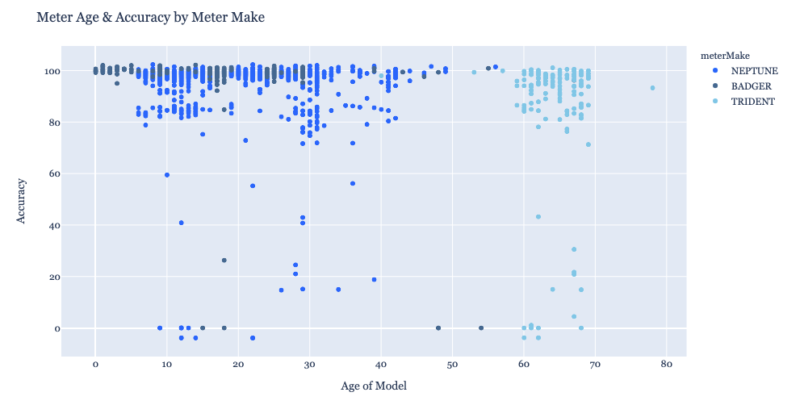
Build Predictive Modeling
03
Using current data and machine learning, build a predictive and adaptive model to identify when meter replacement
allowing for better
budgetary planning,
more discretion on thresholds of performance, and greater insights into the future state of this
key infrastructure

Slide 18
Thank You
Questions?
kristendavis27@gmail.com
(214) 673 - 7739
Please keep this slide for attribution.

